Slide 1

Programming in C
By Maria RAIDY
CSC326 - Operating Systems Laboratory
Fall 2018

Slide 2
Pointers
Every variable is a memory location.
Every memory location has its address defined which can be accessed using ampersand (&) operator, which denotes an address in memory.
Add a line of code to your program to display the address of one of your variables:
printf("Address of var1 variable: %x\n", &var1 );
A pointer is a variable whose value is the address of another variable.
Declaration: type *pointer_name;
Initialize as NULL pointer: type *pointer_name = NULL;
Assigning a value: pointer_name = &var;

Slide 3
Pointers
you can declare a pointer-to-pointer-to-type variable.
Ex: int **pptr;
Ptr + 1 is the next memory location
Ptr –1 is the previous memory location
These arithmetic operators auto-adjust the address offset according to the type of the pointer.
Ptr +1 = ptr + sizeof(int)
Ptr +1 = ptr +sizeof(double)

Slide 4
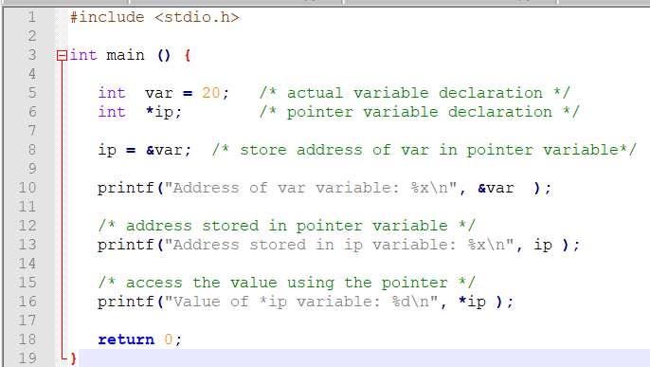
Address of var variable: bffd8b3c
Address stored in ip variable: bffd8b3c
Value of *ip variable: 20

Slide 5
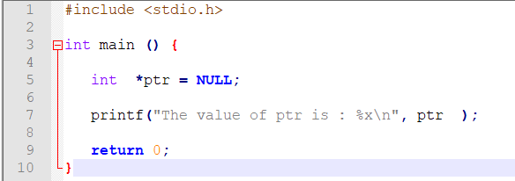
NULL Pointers
The value of ptr is 0
if(ptr) /* succeeds if p is not null */
if(!ptr) /* succeeds if p is null */

Slide 6
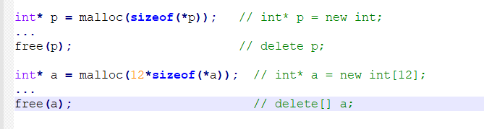
New and delete

Slide 7
Pointers as function arguments
Pass By Value: void fcn(int foo)
When passing by value, you get a copy of the value. If you change the value in your function, the caller still sees the original value regardless of your changes.
Pass By Pointer to Value: void fcn(int* foo)
Passing by pointer gives you a copy of the pointer. This lets you change the pointed-to value.But you can't change the actual pointer to the data.
Pass Pointer to Pointer to Value: void fcn(int** foo)
Passing a pointer to a pointer to a value.
You can change the value so that the caller will see the change because it's the same memory location as the caller code is using.
You can change the pointer to the value.
You still can't change the pointer to the pointer.

Slide 8
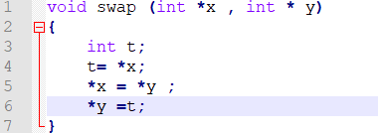
Example
X 5
y
10
5
x
/ 10
t 5

Slide 9
Structures

Slide 10
Structures
Vs Classes
Vs tables
Class:
- private vars
- functions
Struct:
- public vars
- no functions
Table: all elements of the same type
Struct: elements can be of different types

Slide 11
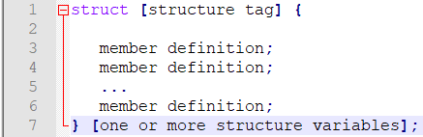
Struct definition

Slide 12
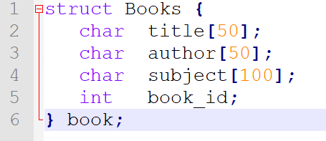
Example 1
http://tpcg.io/7DL5Jk

Slide 13
Example 2
You can pass a structure as a function argument in the same way as you pass any other variable or pointer.
http://tpcg.io/1Kk8Zs

Slide 14
Arrays of struct
Struct Books booklibrary[20];
Strcpy (Booklibrary[1].name, “C how to program”)

Slide 15
Pointers to Structures
Like all other data types.
struct Books *struct_pointer;
struct_pointer = &Book1;
To access the members of a structure using a pointer to that structure, you must use the → operator as follows:
struct_pointer->title;
Example 3: http://tpcg.io/WOoGiV

Slide 16
Struct in struct
You can create a struct called Authors that specifies first name and last name.
You can declare a variable author of type Authors in Books struct.
Usage:
Book1.author.firstname

Slide 17
Linked-Lists

Slide 18
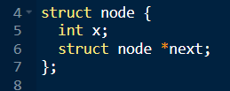
Linked-lists
A dynamic set of items called nodes which order is determined by the link stored in each previous node
Node
Info | *link
Last node
Info | *link
NULL
The pointer to a linked-list points to its first node and is called head
The search in a linked-list is sequential from the head to the last node
Advantage: infinite length – quick sort

Slide 19
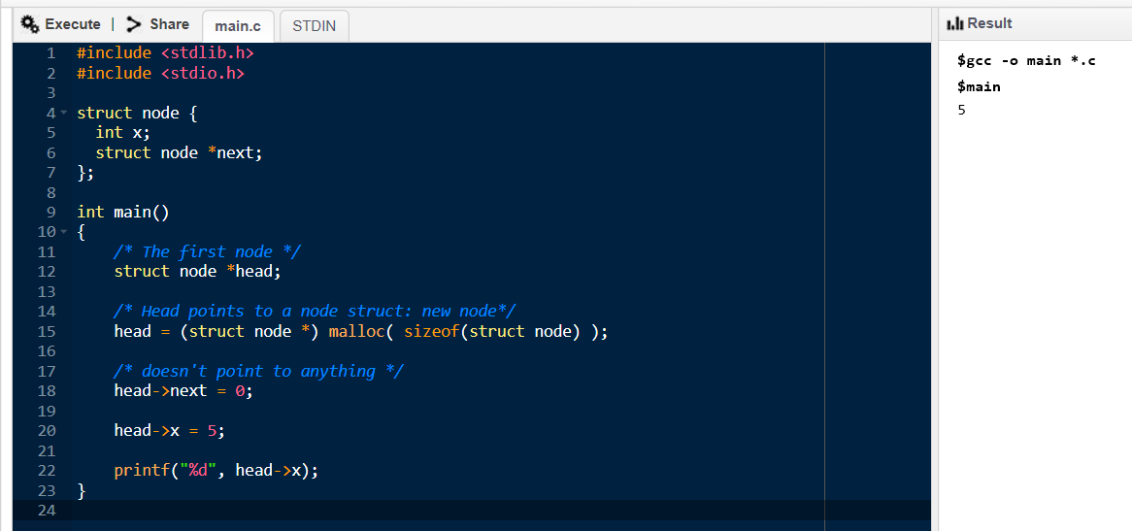
Head node
Head
5
NULL

Slide 20
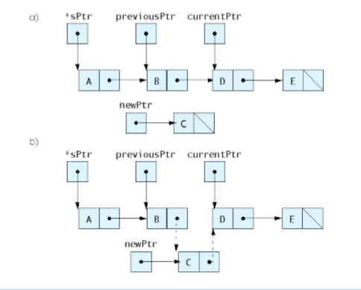
Inserting a node

Slide 21
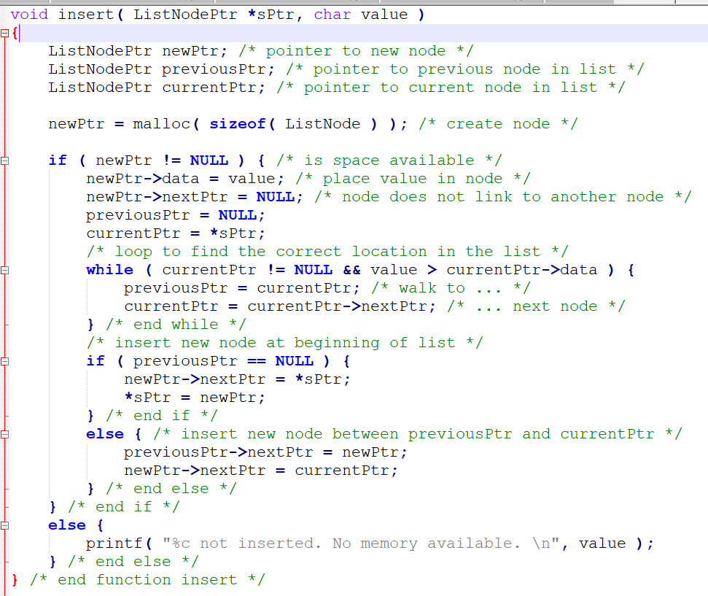

Slide 22
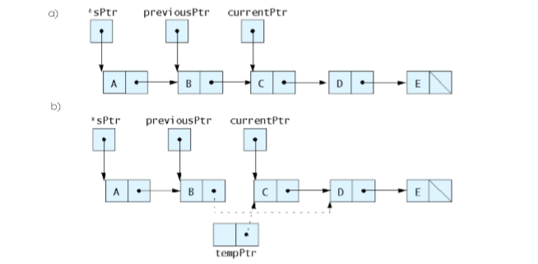
Delete

Slide 23
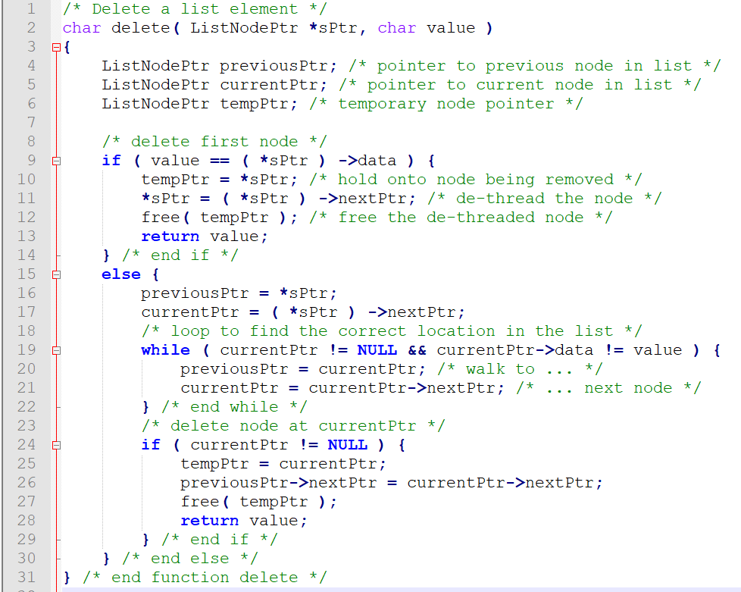

Slide 24
Exercise 1:
Define:
struct gradeNode {
char lastName[ 20 ];
double grade;
struct gradeNode *nextPtr;
};
typedef struct gradeNode GradeNode;
typedef GradeNode *GradeNodePtr;

Slide 25
A
1MIN
Create a pointer to the start of the list called startPtr. The list is empty.
Define:
struct gradeNode {
char lastName[ 20 ];
double grade;
struct gradeNode *nextPtr;
};
typedef struct gradeNode GradeNode;
typedef GradeNode *GradeNodePtr;

Slide 26
A
1MIN
Create a pointer to the start of the list called startPtr. The list is empty.
GradeNodePtr startPtr = NULL;

Slide 27
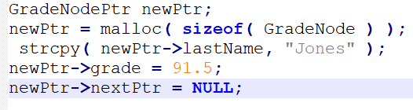
B
3MIN
Create a new node of type GradeNode that’s pointed to by pointer newPtr of type GradeNodePtr.
Assign the string “Jones" to member lastName and the value 91.5 to member grade (use strcpy).
Provide any necessary declarations and statements.

Slide 28
C
5MIN
Assume that the list pointed to by startPtr currently consists of 2 nodes—one containing "Jones" and one containing "Smith".
The nodes are in alphabetical order.
Provide the statements necessary to insert in order nodes containing the following data for lastName and grade:"Adams" 85.0 "Thompson" 73.5 "Pritchard" 66.5
Use pointers previousPtr, currentPtr and newPtr to perform the insertions.
State what previousPtr and currentPtr point to before each insertion.
Assume that newPtr always points to the new node, and that the new node has already been assigned the data.

Slide 29
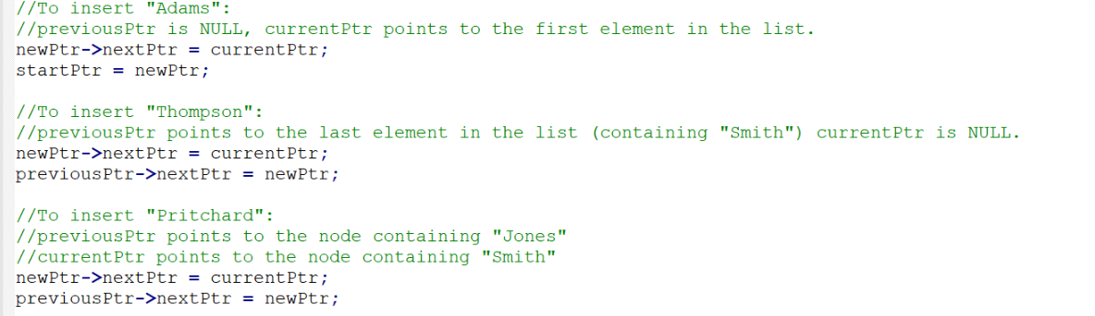
C

Slide 30
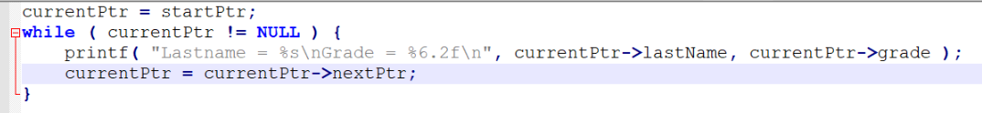
D
3MIN
Write a while loop that prints the data in each node of the list. Use pointer currentPtr to move along the list.

Slide 31
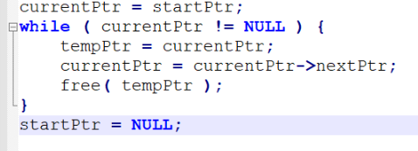
E
5MIN
Write a while loop that deletes all the nodes in the list and frees the memory associated with each node.
Use pointer currentPtr and pointer tempPtr to walk along the list and free memory, respectively.

Slide 32
Stacks and Queues

Slide 33
Stacks

Slide 34
Queues

Slide 35
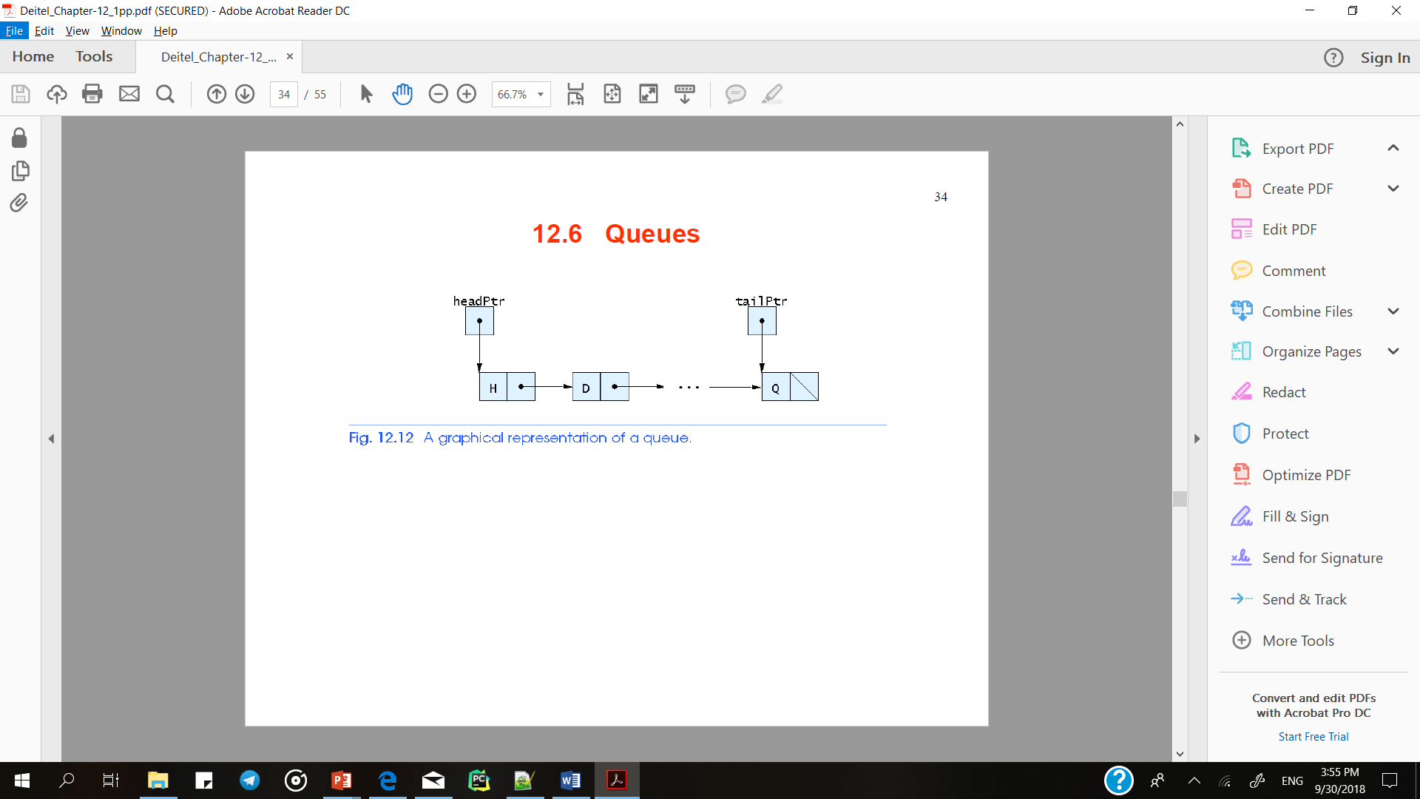

Queues
FIFO
Nodes are removed only from head
Nodes are inserted only at the tail

Slide 36
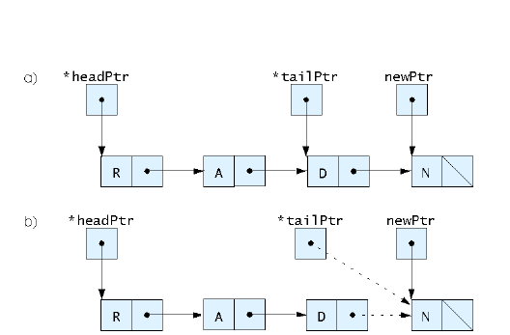
Enqueue

Slide 37
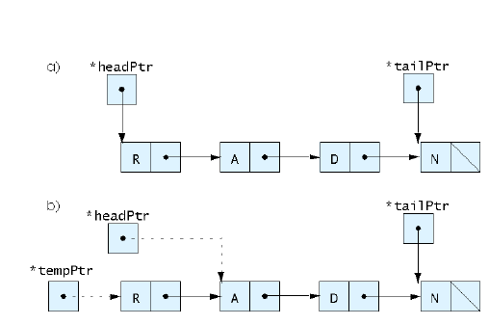
Dequeue

Slide 38
Queues.pdf

